Slide 1



简单高效LaTeX Simple & Effective LaTeX
001 – 开篇和实践介绍 Opening
- GitHub address: https://github.com/yasenstar/learn_latex
- Gitee address: https://gitee.com/yasenstar/learn_latex

Slide 2
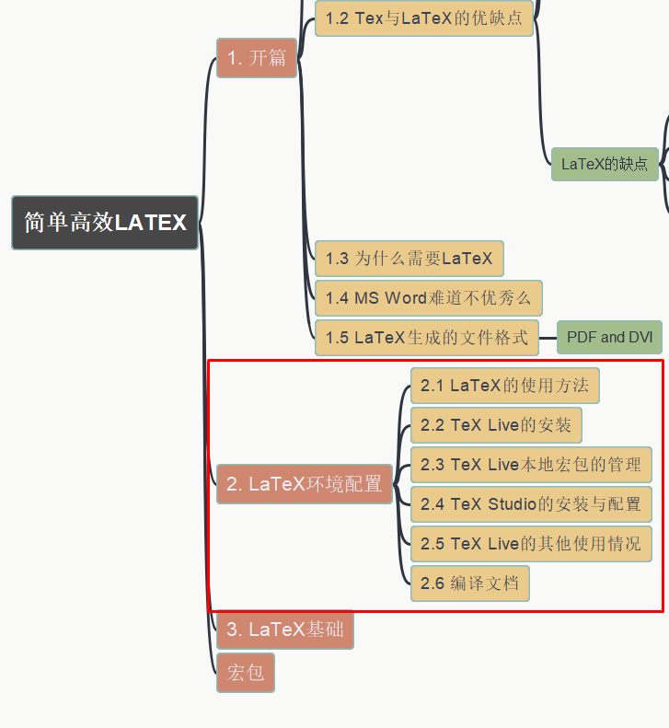
简单高效LaTeX Simple & Effective LaTeX
002 – LaTeX的环境配置
LaTeX Editing Environment Setup
- GitHub address: https://github.com/yasenstar/learn_latex
- Gitee address: https://gitee.com/yasenstar/learn_latex

Slide 3
简单高效LaTeX Simple & Effective LaTeX
003 – LaTeX的环境配置(Cont.)
LaTeX Editing Environment Setup
- GitHub address: https://github.com/yasenstar/learn_latex
- Gitee address: https://gitee.com/yasenstar/learn_latex

Slide 4
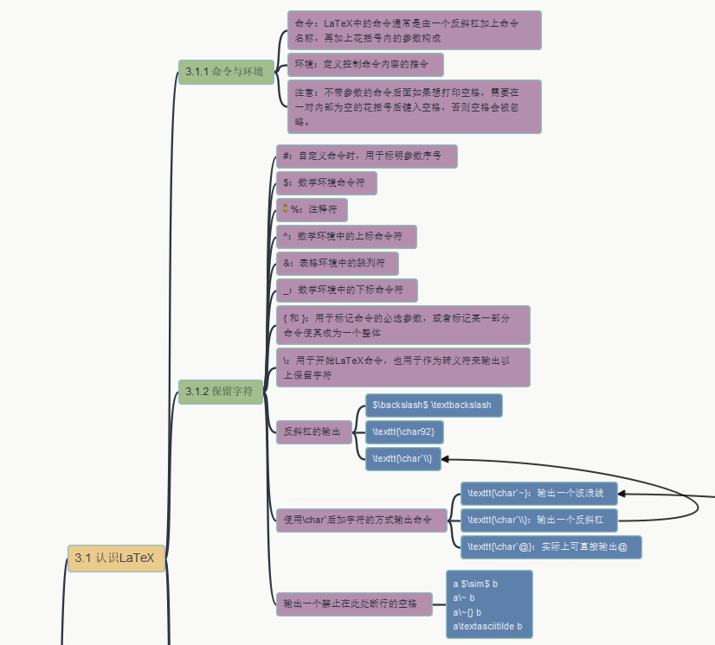
简单高效LaTeX Simple & Effective LaTeX
004 – LaTeX基础 – 3.1 认识LaTeX
3.1.1 命令与环境
3.1.2 保留字符
- GitHub address: https://github.com/yasenstar/learn_latex
- Gitee address: https://gitee.com/yasenstar/learn_latex

Slide 5
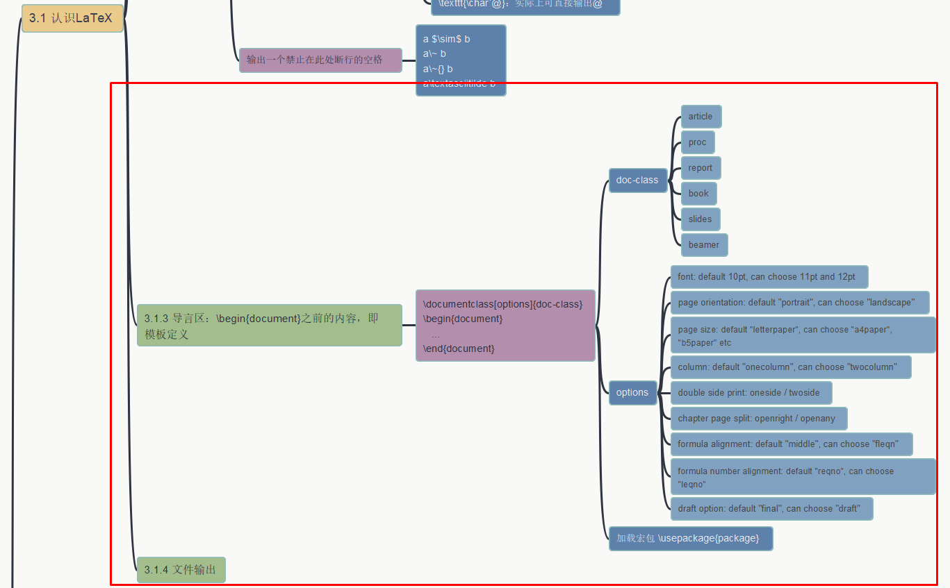
简单高效LaTeX Simple & Effective LaTeX
004 – LaTeX基础 – 3.1 认识LaTeX
3.1.3 导言区，3.1.4 文档输出
- GitHub address: https://github.com/yasenstar/learn_latex
- Gitee address: https://gitee.com/yasenstar/learn_latex

